Slide 1
UEMS council meetings October 2016 and April 2017
Adrian M Agius

Slide 2
Proposal to change ORL official name
Proposal to change our name to ORL Head and Neck in Oct 2015 met with resistance mainly from Maxillofacial board
April 2016 Proposal by Maxillofacial so that a change in any board’s name would have to be approved by all other sections with an interest in that area
Subsequent correspondence and arguments. UEMS April meeting cancelled due to terrorist attacks in Brussels

Slide 3
Meeting between Adrian Agius and maxillofacial Board in presence of UEMS council (Brussels Oct 2016)
ORL predates maxillofacial specialty
ORL specialists see and treat more patients with head and neck conditions that Maxillofacial
In most countries, ORL outnumber maxillofacial many times (30,000 vs 3000) and patients are seen, diagnosed and treated by ORL
Prague declaration-UEMS Board and section meeting Oct 2016
ORL harmonization of training, EBE ORL exam, standard logbook since many years, specialty training programmes

Slide 4
Meeting (3)
Offered name change maxillofacial to craniomaxillofacial-refused
Council will not support a name change for ORL unless there is consensus. Put forward the idea of a MJC (multidisciplinary joint committee) on Head and Neck
This idea was then tabled by the secretary of maxillofacial (Patrick Magennis) in December 2016, who then modified it from Head and Neck oncology to all benign and malignant head and neck conditions. Implications.

Slide 5
April 2017 (Tel Aviv)
New structure of UEMS : three groups representing sections, we are in Group II (surgical). Chairmen of groups on extended UEMS central council, having advisory but no voting capacity
Proposal discussed at Group II meeting before going to plenary session.
Presentation by ORL with arguments against, supported by Radiation Oncology.
Support of the MJC by UEMS council president and vice president as marked by their presence together at the meeting

Slide 6
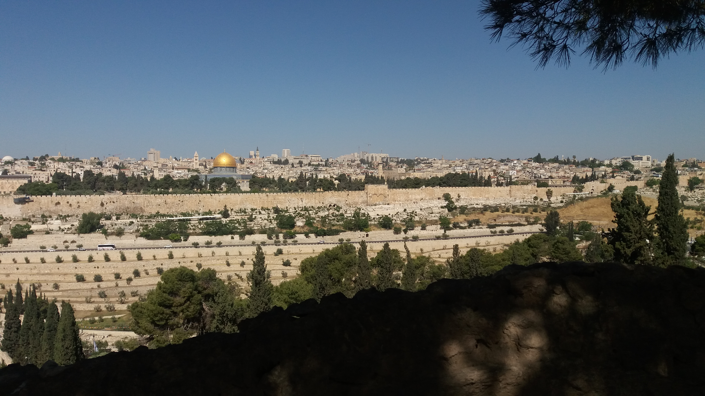
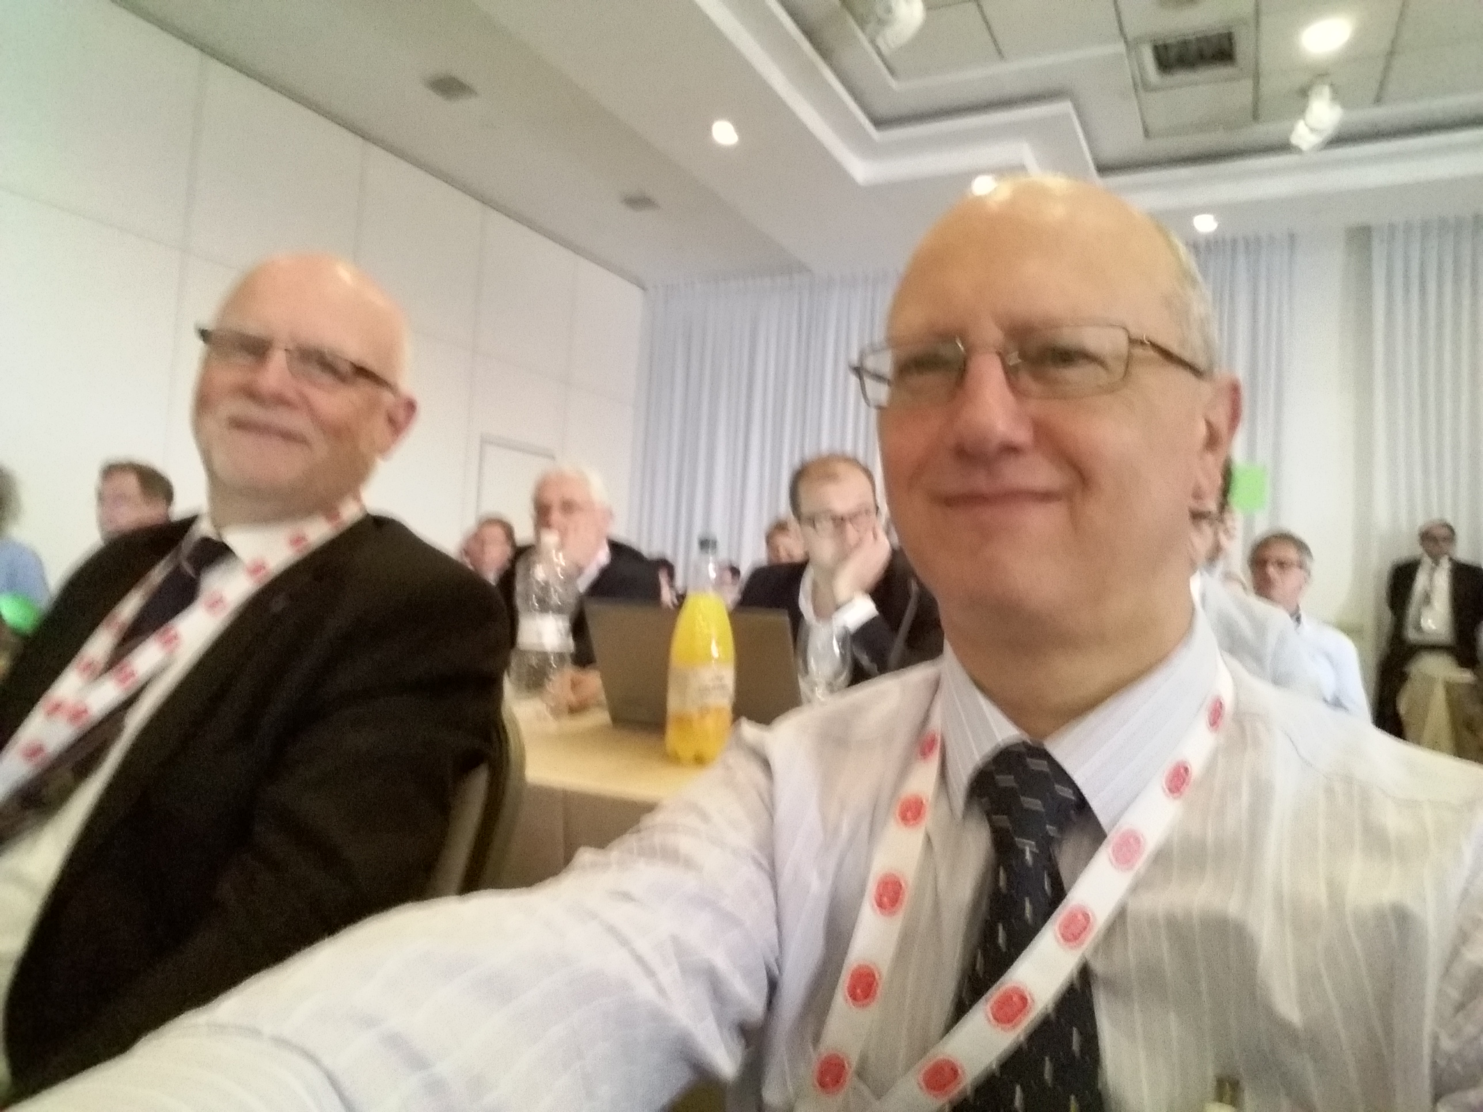
Tel Aviv April 2017

Slide 7
Options in April 2017
Options open to ORL:
refuse and risk approval against our wishes any way if put forward by Council at plenary session where national societies vote (Boards and Sections do not have any vote)
Approve, participate and influence talks within the MJC maybe in direction of oncological and palliative care of head and neck cancer
Therefore in a compromise early morning meeting chaired by VP Papalois, the proposal for MJC was taken off the table for the plenary session and a working group set up to discuss the terms of reference of the MJC. NO meetings since April.

Slide 8
Conditions set by ORL
The role of the MJC is not to influence training requirements in any other section which may already have its training programmes in place
MJC working group to be set up so as to set terms of reference by Oct 2017 (Brussels meeting)
NB Many delegates were absent in Tel Aviv
Meetings attended by Nash Patel from Irish national delegation, who also is ORL HNS

Slide 9
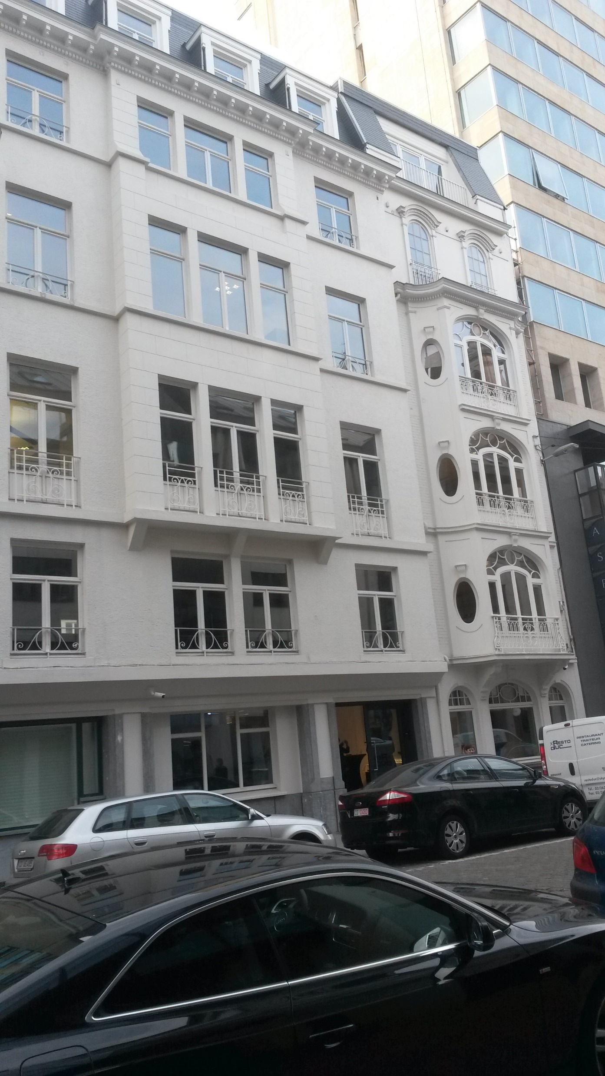
EACCME
Payments for 2016 and 2017 due to Sections have been withheld by Central council to help pay for Domus Medica
They will start to be repaid to the Sections in 2018 with 3% interest

Slide 10
ETR-European training Requirements
Free movement of medical specialists in Europe
Promote Harmonised training
The UEMS respects individual countries’ training programmes
Hoever not all specialties are recognized in all countries
ETR to complement national training
Entails review of training in different countries, produce a high quality programme and submit to UEMS council for approval

Slide 11
MJC vertigo
Proposed by neurologists (Alex Birsdorff)
Initially thought as cooperation/two way knowledge transfer in this complex clinical area
Curriculum/training documents-refused, we already have joint Otology/EANO subspecialty document, do not want further duplication
Further talks Brussels October 2017

Slide 12
ETR
Competency based
Duration of training
European specialist as a clinician, academic, team leader
Discussion with specialties of neighbouring clinical areas
Standards of training departments and visitations
Examinations
Fellowships

Slide 13
Discussion

