Slide 1
Union europeenne des medecins specialistes
ORL Geneva 2013 10 04 – 06 Geneva switzerland
Dr Dr H.-P. Ulrich
2013

Slide 2
THE uems
55
The largest European Medical Organisation (35 countries, > 1.4 mln. specialists)
Large Association Internationale Sans But Lucrative
Key activities include:
standard setting for specialist training and practice
accreditation of CME/CPD
political lobbying

Slide 3
THE ADDED VALUE OF THE UEMS
development of modern, harmonised models for the training of the next generation of medical specialists
an independent body for international accreditation of CME (US, Canada)
addressing interdisciplinary issues in emerging areas of specialist medical practice
peer review and approval of specialty documents, education

Slide 4
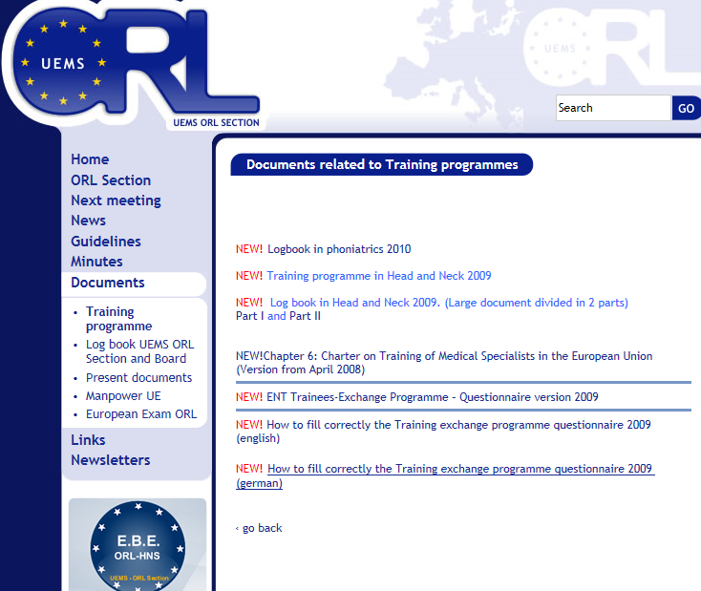

Slide 5
Council
Specialist Sections
Multidisciplinary Joint
Committees
Board
European Boards
Divisions
Working Groups
Task Forces
Committees
Executive
Secretariat
Brussels
UEMS Standing Committee
on CME/CPD
Governance Board
UEMS Standing Committee
on Quality of
Specialist Practice
Governance Board
UEMS Standing Committee on
Post Graduate Training
Governance Board
UEMS ECAMSQ
European Council for Accreditation
of Medical Specialist Qualification
UEMS EACCME
European Accreditation
Council for CME
UEMS EACQMSP (?)
European Advisory Council
for Quality Management
of Specialist Medical Practice
CESMA

Slide 6
SECTIONS AND BOARDS
Specialist Sections
Multidisciplinary Joint
Committees
41 Sections and European Boards
23 Divisions
10 Multidisciplinary Joint Committees
1 Thematic Federation (Legal Medicine)
22 endorsed Training requirements for Specialty
Visitation programmes
New template for „Training Requirements in Specialty of ...” (old Chapter 6)
European Boards
Divisions

Slide 7
Statutes

Slide 8
IV.1. Full Members The UEMS is composed of at least three full Members, legitimate persons/entities, legally constituted in keeping with the laws and customs of their country of origin. Any organisation representing specialist medical doctors, having legal personality or constituted in keeping with the laws and customs of its country of origin, can also become a full Member of the UEMS under the following condition: Only the most representative non-governmental national professional organisation of a European Union Member State or a signatory country of the European Economic Area Agreement and Switzerland representing medical specialists may be elected to become a full Member of UEMS.

Slide 9
Article X. Specialist Sections and their European Boards
X.1. Competencies
The Specialist Sections (hereafter Sections) represent the interests of their particular Specialty.
Any specialty may apply to Council to create its own Section if it is recognised as an independent specialty in at least 1/3 of the Member States.
Every Section has the right to create its own Board to address scientific and training interests.
X.2. Composition
Each delegation to a Section shall consist in 2 delegates from the country of each member country of the Council of UEMS nominated by that member of Council. Each delegation to a Board shall consist in 2 members, one from the Section and one from
the recognised academic or scientific Society of the country.
11

Slide 10
Accounts & Subaccounts

Slide 11
Why a change is needed?
UEMS statutes (art. X) and rules of procedure (art. VI) foresee that the Specialist Sections are internal bodies within a single Belgian legal entity (AISBL Association Internationale Sans But Lucratif ).
The Specialist Sections have indeed no separate legal existence.
Therefore, they are considered internal bodies within UEMS.
The UEMS Statutes do not allow for existence of UEMS Sections as parties external to UEMS (separate legal entities).

Slide 12
Why a change is needed (2)
As a Belgian legal entity under the form of an AISBL, UEMS must disclose all its economical operations,
including the ones done through the Sections.
The Governments of the European countries are more and more concerned about financial transparency. Unclear situations are under growing scrutiny and pressure.

Slide 13
Principles for change (1)
All operations should be done on behalf and in the name of UEMS AISBL
All financial accounts have to be recognized as « UEMS AISBL » accounts.
All invoices, contracts, etc. have to be labeled as invoices drafted by or to « UEMS AISBL ».

Slide 14
Principles for change (2)
Full application of art. XIII of UEMS statutes:
« All acts concerning the UEMS are, except for specific proxies, signed by the President ant the Secretary General, or, in his absence, by two designated members of the Enlarged Executive. »

Slide 15
Principles for change (3)
The UEMS accounts should include all deals, operations, expenses and revenues of its sections.
The bank statements and all financial documents should be kept within UEMS central office (with copies kept by the Sections).
The Sections should send to UEMS central office all the documentation supporting financial operations without delay in order to allow for timely reporting to tax authorities. (scans or originals)

Slide 16
CEN

Slide 17
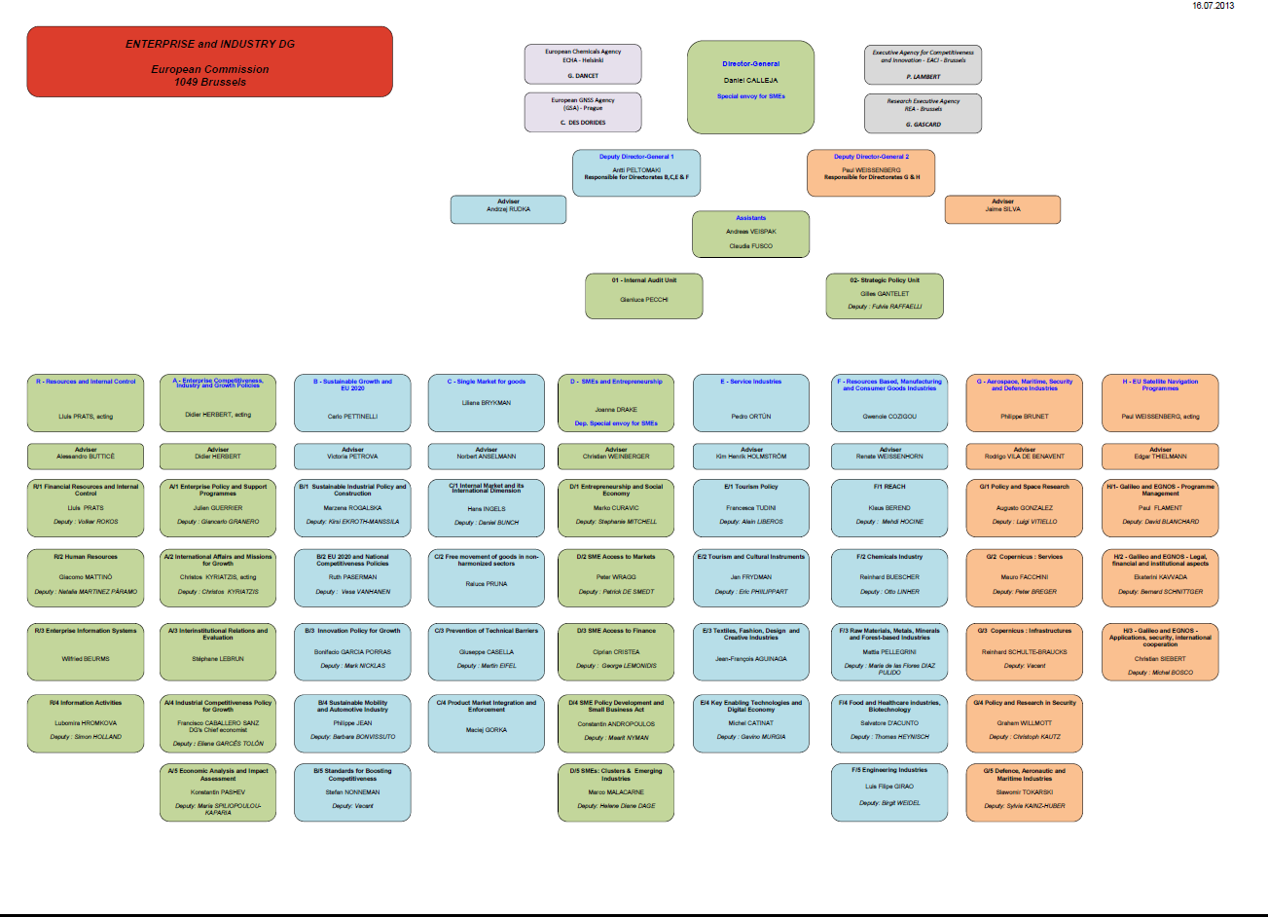

Slide 18
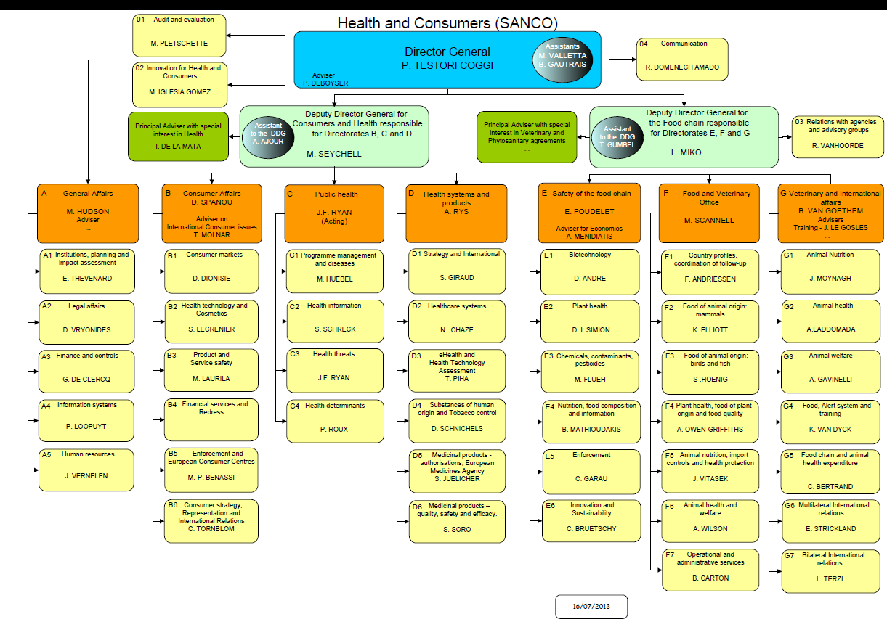

Slide 21
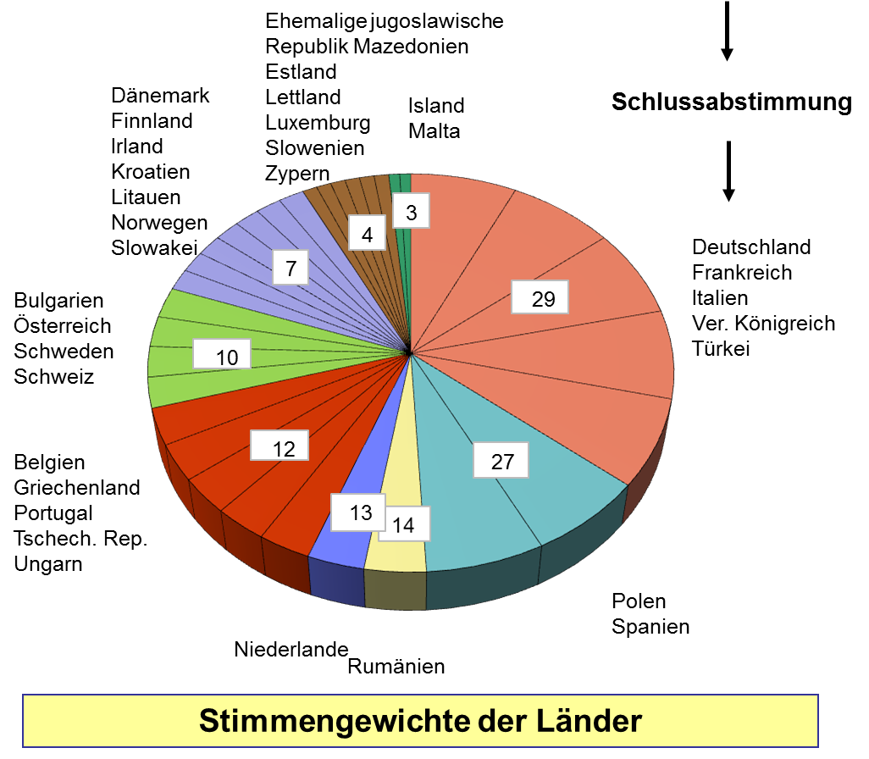

Slide 22
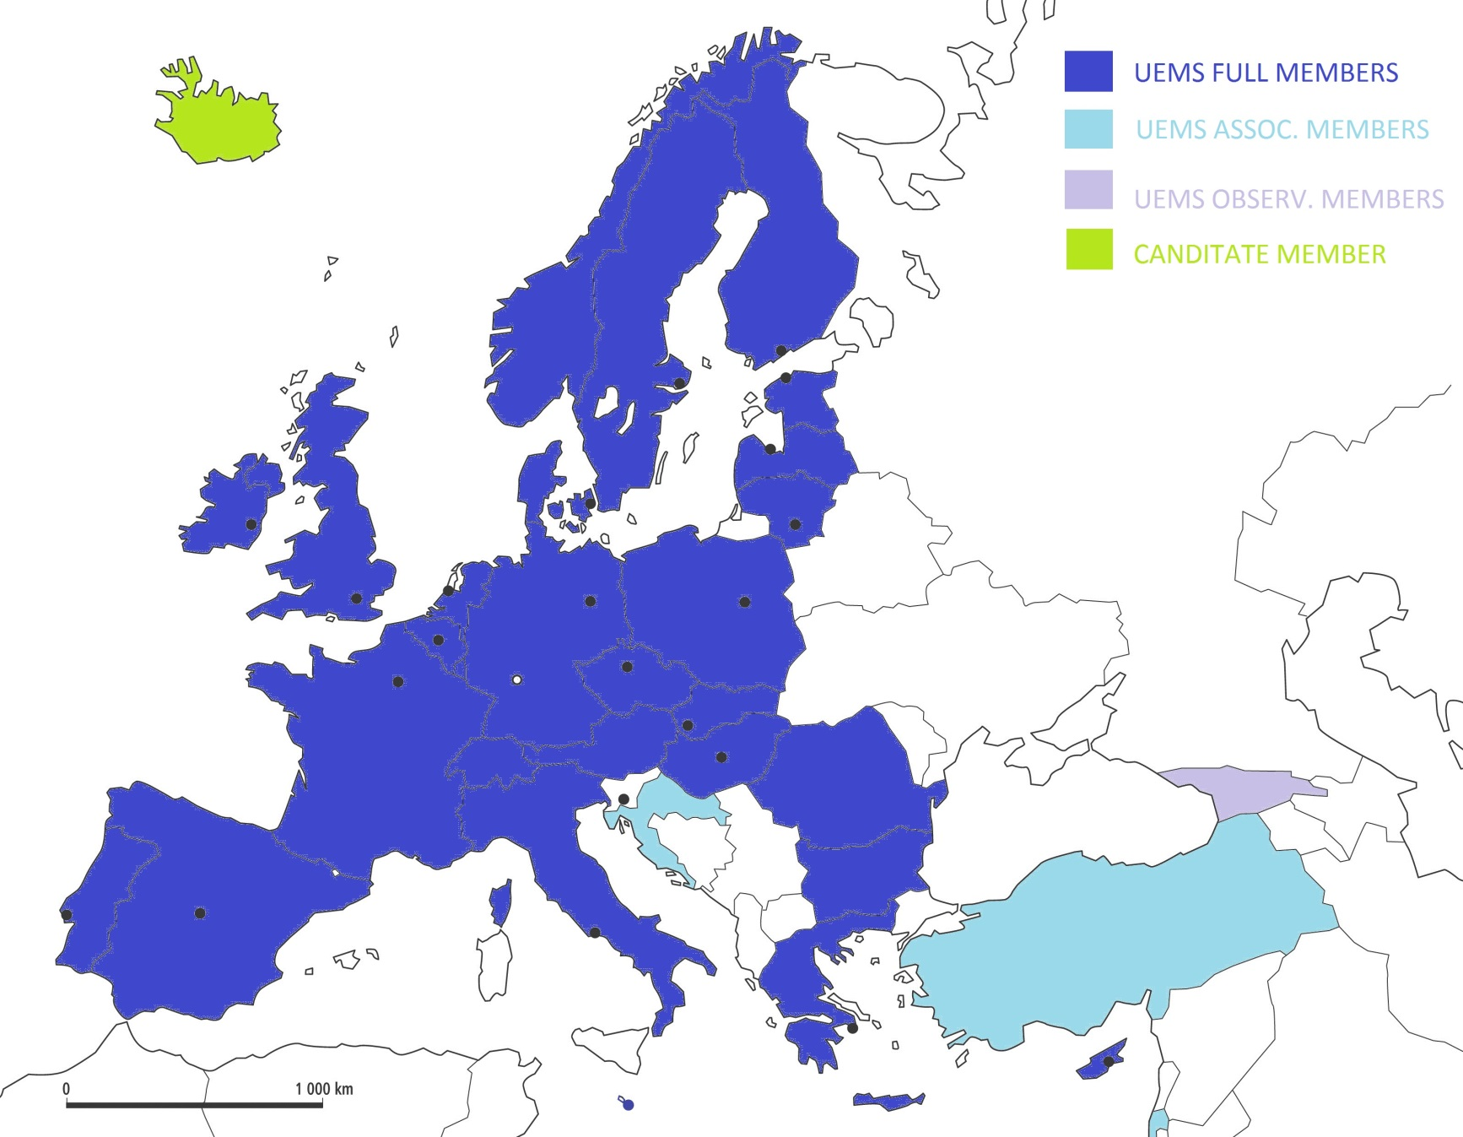
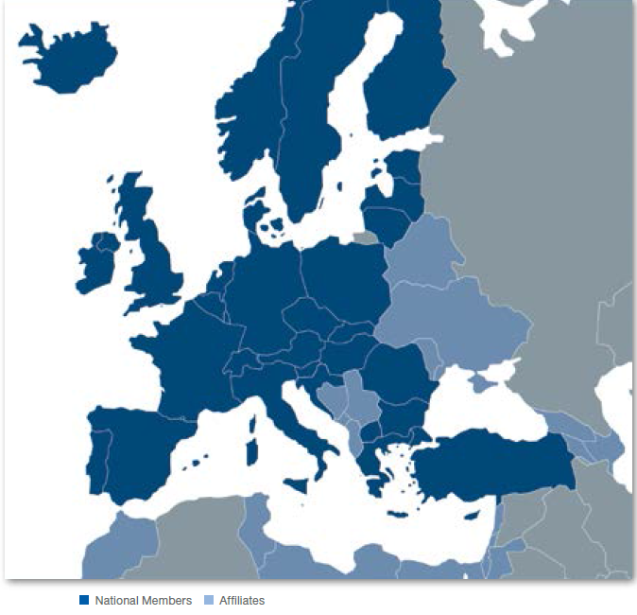
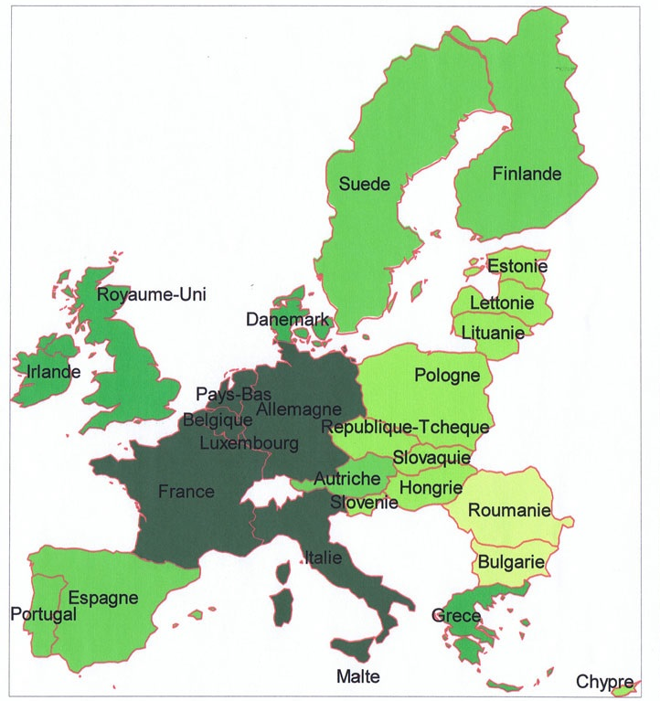

Slide 23
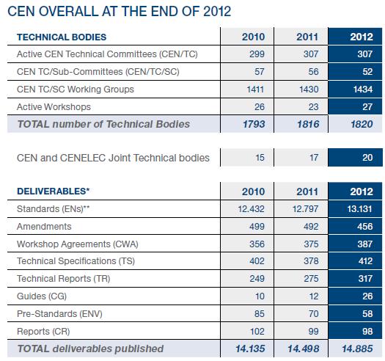
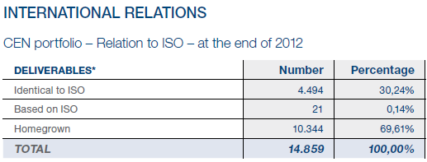

Slide 24
CEN in FIGURES
In 2012, CEN produced 1148 documents (ENs - Standards, TSs – Technical
Specifications, TRs - Technical Reports, CGs - CEN Guides and CWAs - CEN Workshop
Agreements).
The total number of living documents to date is 14.885 (end December 2012).
At the end of 2012 3337 documents were in preparation.
CEN currently has 1994 Technical Bodies, whereof:
307 active CEN Technical Committees
27 active CEN Workshops
52 CEN Technical Committees/Sub-committees
1434 CEN Working Groups
17 CEN-CENELEC Technical Committees
1 CEN-CENELEC Workshop
2 CEN-CENELEC Working Groups

Slide 25
Aesthetic Plastic Surgery
The Austrian standard institute (ASI) asked the CEN on January 18th 2010 to create a directive on aesthetic plastic surgery.
It was accepted by resolution CN/BTC 915/2010 and CEN created new
project CN/TC 403 aesthetic surgery services.
By the evaluation of the German medical chamber – BÄK – this creation and the application is not in coherence with the
European Directives 2005/36 EC and 2006/123/EC as well as it is violating article 168/7 AEUV (Treaty about the working procedures of EU) which requires, that health policy is only within the organisations of the national health systems.
Never the less, in violating the above mentioned rules, CEN accepted this application with 25 in favour and four abstentions.
Belgium, the Netherlands, Austria, Slovakia and the UK
amended their active participation in the work of this process with project CN/TC 403 and it was installed with the resolution BTC 015/2010.

Slide 26
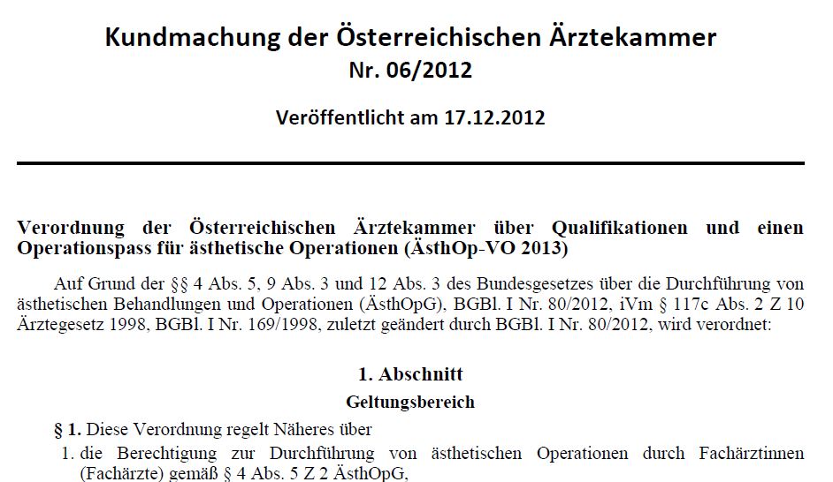

Slide 27
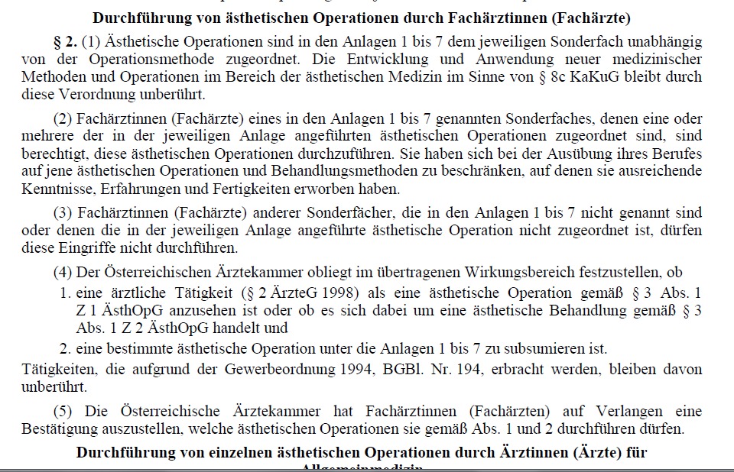

Slide 28
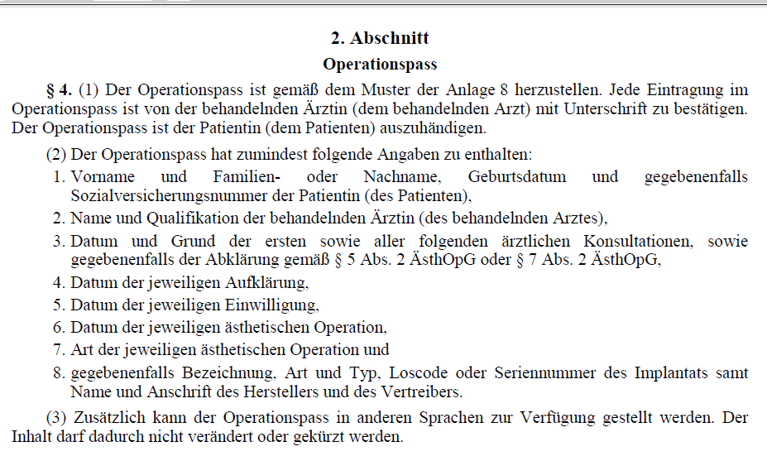

Slide 36
Wien 2013 08 31

Slide 37
Standardization of medical procedures
UEMS did not start and does not support CEN TC/403 initiative
declined offer from CEN to cooperate 09.2011
requested 05.2012
repeated request to remove any reference to UEMS 11.2012
Joint statement by EMOs (Nov. 2012).

Slide 38
CEN Projects
Aesthetic Surgery Services (CEN/TC 403)
Project Committee - Care Services of Cleft Lip and / or Palate, technical Report (CEN/TC 424)
Services of Chiropractors (CEN/TC 394),
Project Committee services of Osteopath (CEN/TC 414),
Project Committee services for medical doctors with additional qualification in homeopathy

Slide 39
Good News
Not legally binding
only national law
Bad News
Declaration of an A deviation for each item
by the national institute of normation

Slide 40
NEXT UEMS MEETINGs
UEMS Council, 18-19.2013, Paris
Discussions between UEMS Sections – Groupings
Working Groups meeting (e-Health, PGT, CME/CPD, Specialist practice, Quality in Patient Care)
Discussion Forum on Patient Safety
Board and Council Meeting
CME conference 28.02.2014, Brussels
Crown Plazza, Brussels
UEMS Council, 11-12.04.2014, Brussels

Slide 41
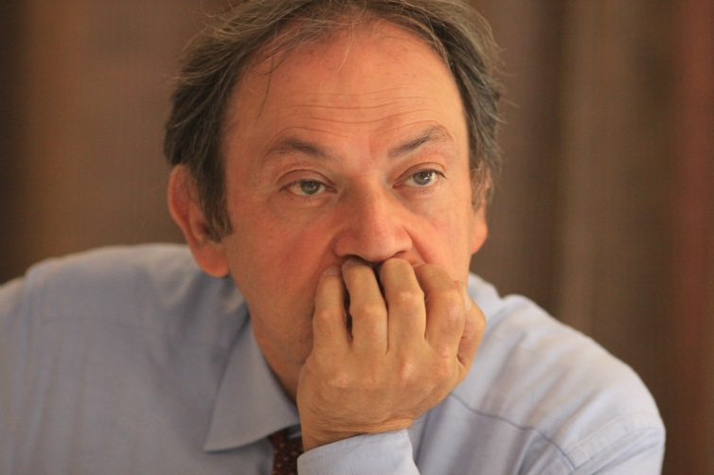
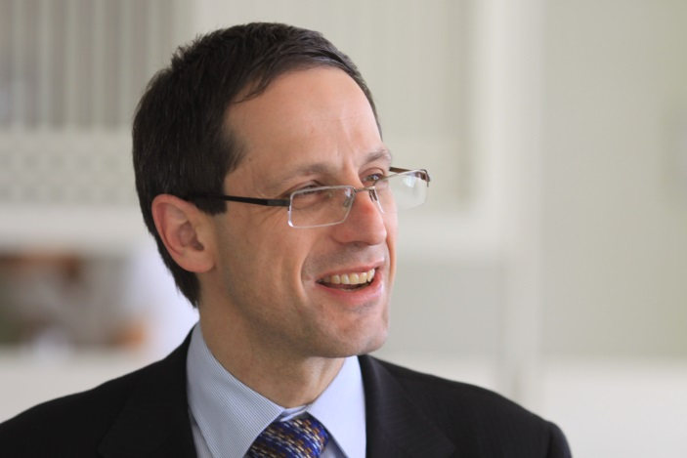
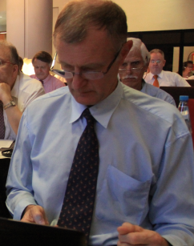
j

Slide 42
