Slide 1
Report-UEMS meeting Marrakech 27, 28 April 2018
Adrian M Agius
General Secretary UEMS-ORL

Slide 2
Attended by John Fenton, President and Adrian Agius, General Secretary

Slide 3
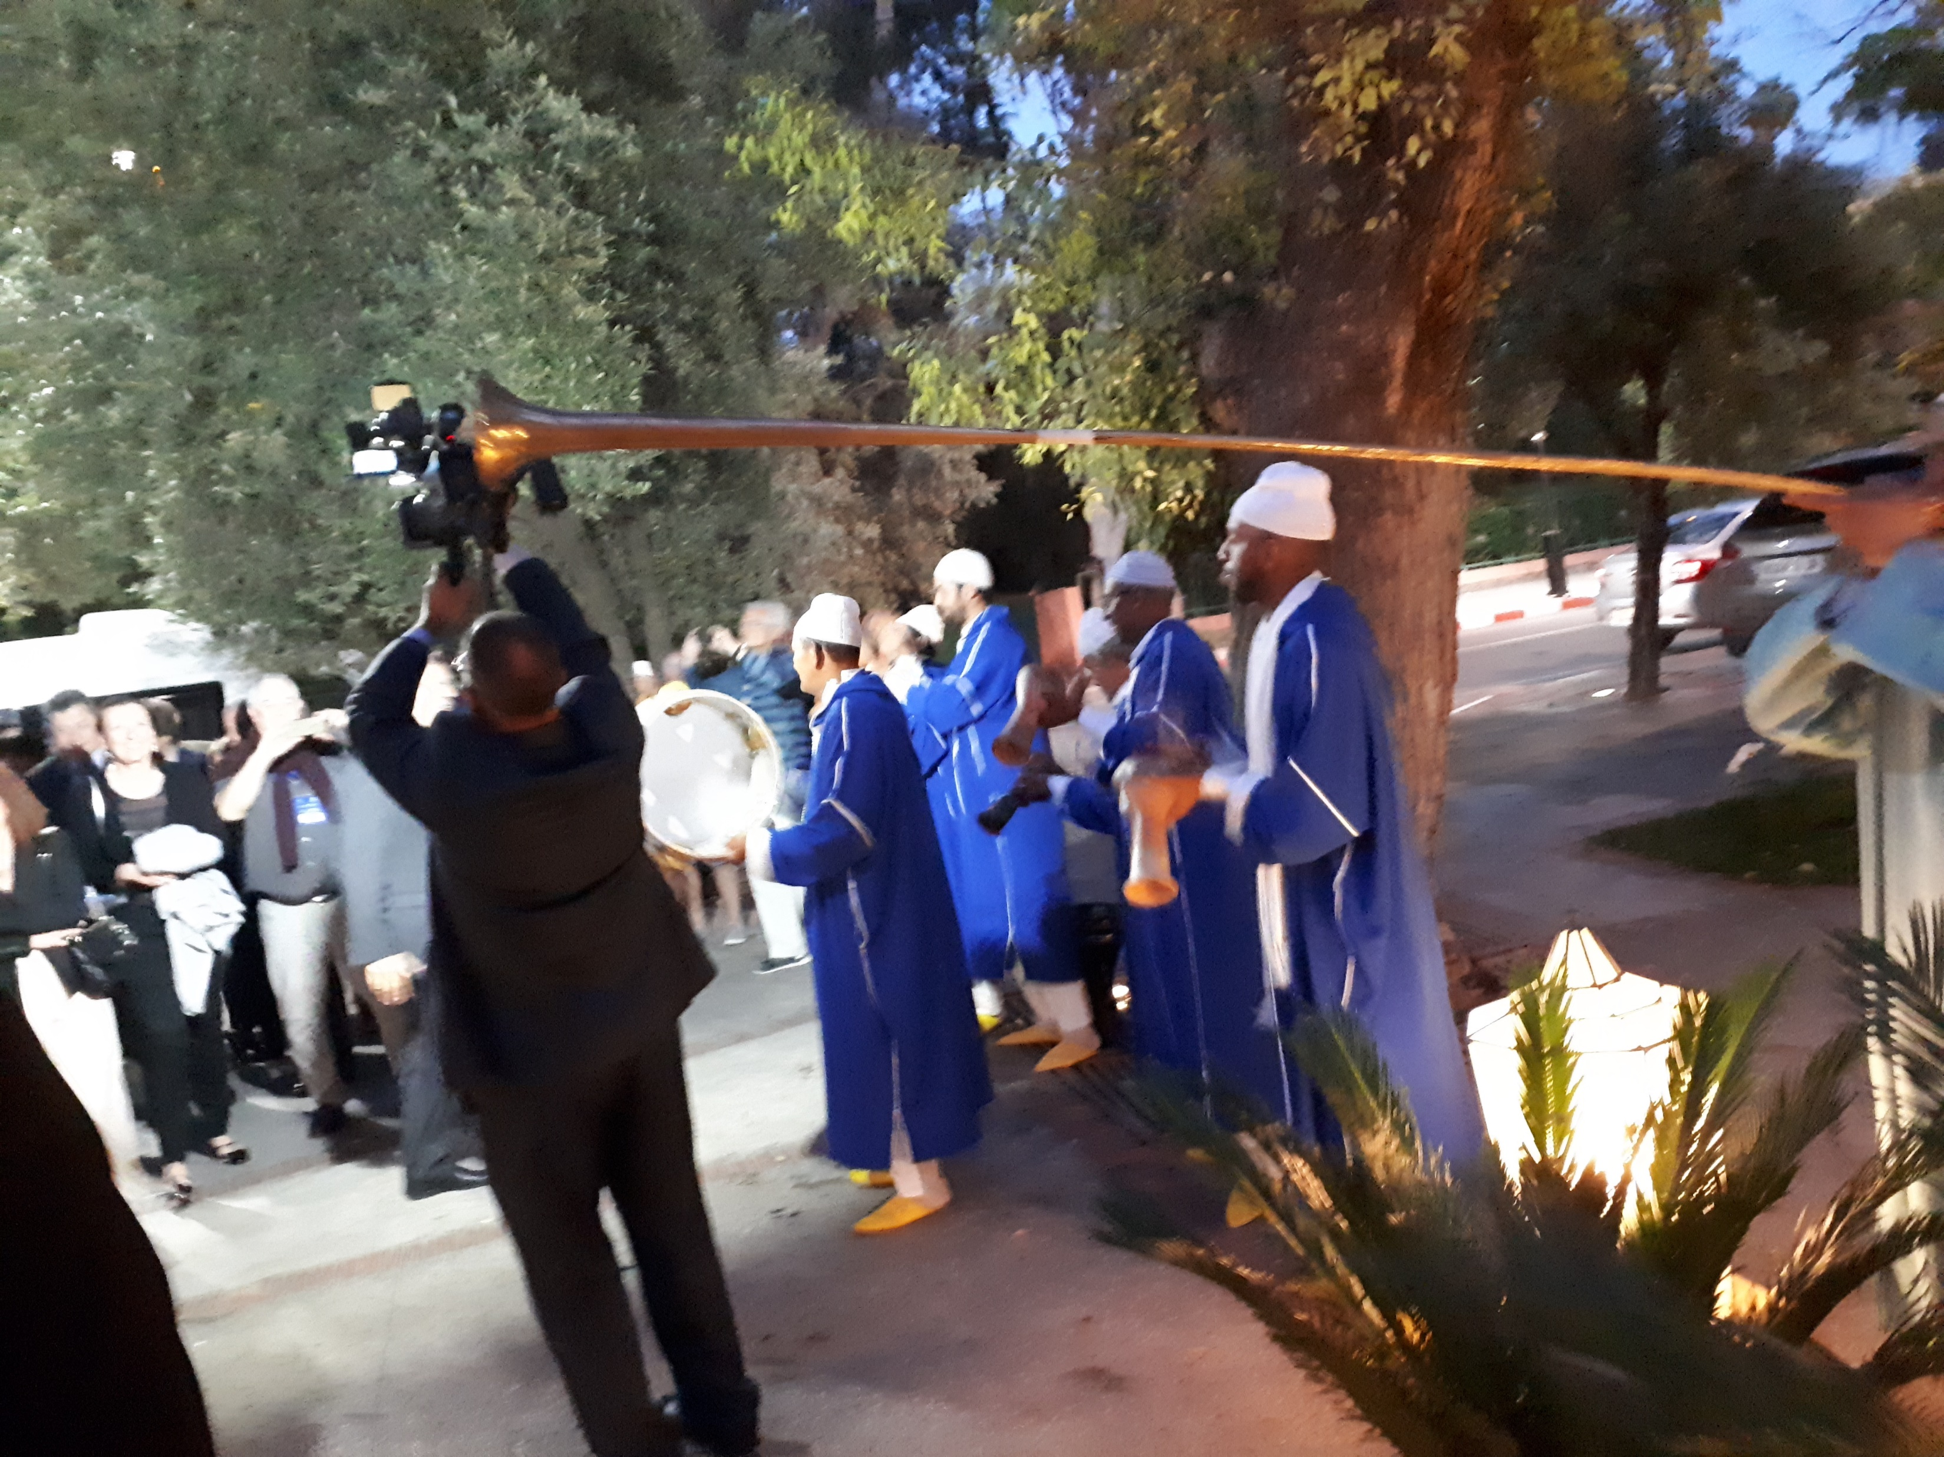
60th Anniversary of founding of UEMS

Slide 4
UEMS financial status
The UEMS incorporates 43 sections and Boards. It is funded by National Medical Associations of member countries, makes approx. 250,000 € annually from these contributions.
UEMS central has 9.5 million € mainly in assets (Domus Medica) and for the year 2017 was 800,000€ positive on balance sheet while in 2015 there was a negative balance of 300,000€. This was reversed due to withholding of EACCME payments that were due to the sections. These are starting to be repaid in 2017. There is an outstanding loan of 1 million € to be paid by 2027.

Slide 5
EACCME dues being reimbursed as from 2017 (withheld previously due to financial situation of the Domus Medica)
Internal Medicine € 5.100 2017.09.05 € 4.400 2018.04.10
Medical Biopathology € 50 2017.09.19 € 900 2018.04.10
Microbiology € 2.100 2017.09.05 € 450 2018.04.10
Nephrology € 2.550 2017.09.04 € 2.150 2018.04.10
Neurology € 6.450 2017.09.05 € 6.200 2018.04.10
Neurosurgery € 2.650 2017.09.05 € 2.000 2018.04.10
Nuclear Medicine € 1.500 2017.09.05 € 4.050 2018.04.10
Occupational Medicine € 50 2018.04.10
Oncology € 2.510 2017.08.29 € 2.184 2018.04.10
Ophthalmology € 6.100 2017.09.05 € 4.200 2018.04.10
Oro-Maxillo-Facial surgery € 550 2017.09.05 € 250 2018.04.10
Orthopaedics € 6.150 2017.09.05 € 5.500 2018.04.10
Oto-Rhino-Laryngology € 2.200 2017.09.05 € 2.250 2018.04.10

Slide 6
UEMS management fee
In 2016 The UEMS Executive has started to discuss the possibility to evenly share the costs of administration and financial management among all UEMS bodies. The Brussels Office was commissioned to put in place an adequate proposal for approval in 2018.
This is about the overall management of all financial UEMS activities needing proper control, documentation and a reporting system which will allow an External Auditors’ certification of the UEMS accounts.

Slide 7
NGO status
The UEMS central office has the responsibility to fulfill the fiscal and financial obligation for the whole UEMS organization including:
Monthly VAT calculation and filing for the whole organization (20,000 transactions annually by UEMS bodies)
Reconciliation of all bank transactions with supporting document provided
Recording all expenses provided by the section on a central accounting software
Follow up of the section’s contribution and examination income
Completing all year end reporting and filing for UEMS bodies
Review with internal auditors

Slide 8
Fiscal responsibility
The UEMS’ efforts to streamline the financing and accounting management aim to comply with Belgian regulations and to successfully achieve certification of its accounts by an external auditor. It is also important to bear in mind that UEMS including all its bodies must act as one entity liable to Belgian legal and fiscal authorities.

Slide 9
Proposed management fees

Slide 10
Name | Balance (EUR) | management fee
 | 31/12/2017 | OPTION 1 | OPTION 2 | OPTION 3 | OPTION 4 | OPTION 5
 |  | based on resources | based on number of transactions | 2/3 on resources & 1/3 number of transactions | 1/2 on resources & 1/2 number of transactions | 1/3 on resources & 2/3 number of transactions
BNP ALLERGOLOGY | 45375,08 | 1223 | 663 | 1036 | 943 | 850
BNP ANAESTHESIOLOGY | 7765,39 | 209 | 610 | 343 | 410 | 476
BNP NEUROLOGY | 75676,89 | 2041 | 2999 | 2360 | 2520 | 2680
BNP NEURORADIOLOGY | 17983,97 | 485 | 823 | 598 | 654 | 710
BNP PAEDIATRIC SURGERY | 9401,52 | 253 | 1300 | 602 | 777 | 951
BNP MEDICAL BIOPATHOLOGY | 100268,22 | 2704 | 1406 | 2271 | 2055 | 1839
BNP PATHOLOGY | 29343,67 | 791 | 1221 | 934 | 1006 | 1078
BNP ORTHOPAEDICS | 12061,7 | 325 | 955 | 535 | 640 | 745
BNP RADIOLOGY | 119511,41 | 3222 | 2229 | 2891 | 2726 | 2560
BNP MEDICAL MICROBIOLOGY | 39659,89 | 1069 | 849 | 996 | 959 | 922
BNP VASCULAR SURGERY | 81649,37 | 2202 | 5493 | 3299 | 3848 | 4396
BNP NEUROSURGERY | 8733,85 | 235 | 398 | 289 | 317 | 344
BNP CHILD & ADO PSY | 31324,04 | 845 | 902 | 864 | 874 | 883
BNP GYNAECOLOGY | 600635,85 | 16195 | 9500 | 13963 | 12848 | 11732
BNP ENDOCRINOLOGY | 303562,71 | 8185 | 1778 | 6049 | 4982 | 3914
BNP DERMATOLOGY | 138680,52 | 3739 | 6236 | 4571 | 4988 | 5404
BNP GERIATRICS | 14190,86 | 383 | 1300 | 689 | 842 | 994
BNP PAEDIATRICS | 156020,68 | 4207 | 1221 | 3212 | 2714 | 2216
BNP ORL | 19923,44 | 537 | 1884 | 986 | 1211 | 1435

Slide 11
Meeting of working group in head and neck not held due to overrunning of congress time since discussions on management fees were prolonged. Probably not enough time was allocated for this.

Slide 12
Statement of European Medical Organizations
Recently physiotherapists asserted that they have the right to prescribe medication. There was some encouragement by governments of Portugal and Poland where to cut costs they appointed nurse practitioners and intend to allow patients to access physiotherapists directly without referral from doctors. A statement was issued by EMO confirming that only doctors have the training to make diagnosis and write prescriptions for medication.

